Slide 1
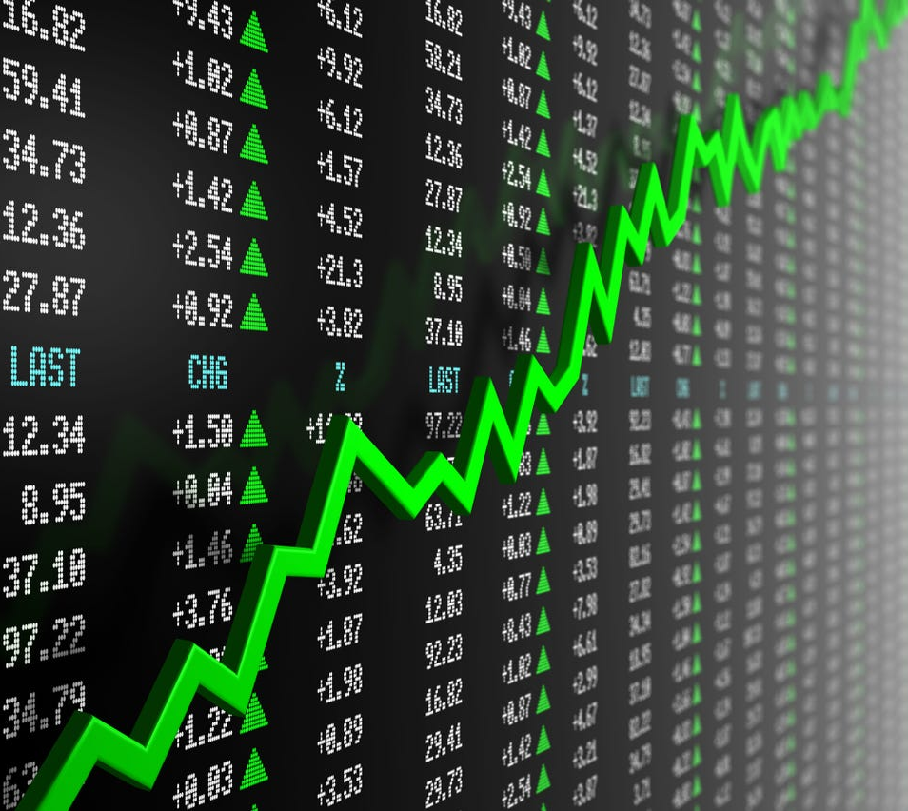
Data Management Final Project
Rohith Ganni
Lizbeth Garcia
Pranthi Cavuturu

Slide 2

What factors give insight to stock trends?
Market Share (volume): trading volume of stock
Maintaining or gaining market share is a positive sign of a company's competitiveness.
Investor Sentiment and Volatility (open)(close):Represents the % change of the opening and closing price of the stock
Analyzing percentage changes can help assess investor sentiment. Consistent positive changes may indicate positive market sentiment, while consistent negative changes may suggest a negative sentiment.
High percentage changes, whether positive or negative, can indicate increased volatility in the stock. This might be due to news, earnings reports, or other factors affecting investor perception.

Slide 3


Data Extraction
Extracted JSON using AlphaVantage API through Python
Extracted stocks data for every five minutes

Slide 4



Our Data set:
Overview of three major stock companies: Microsoft, Apple,
and International Business Machines Corporation
Data set composition:
Hourly data points of each company over a day
Black Friday (November 24,2023)
Parameters measured:
Time: This column represents the time or timestamp of the data.
open: Represents the opening price of a stock at a particular time..
close: Represents the closing price of the stock at a
given period.
volume: Represents the trading volume of the
stock at a given period.

Slide 5
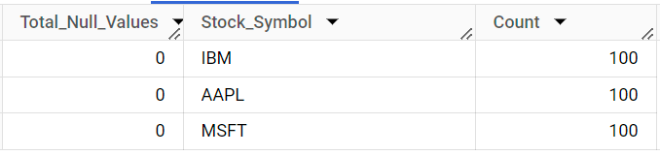
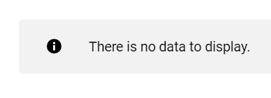
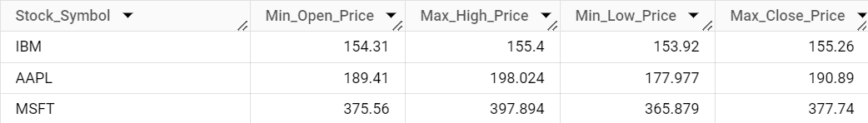
Data Validation
Null, Unique Values
Data Consistency
Range and Outlier

Slide 6
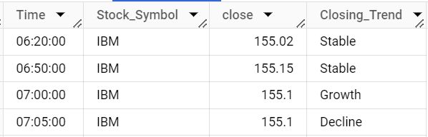
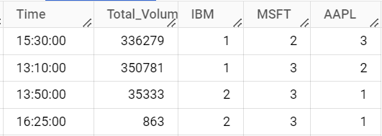
Data Transformation
Split the Timestamp into separate Date and Time columns for detailed time-series analysis.
Classified each stock's closing trend compared to its closing price 10 minutes earlier.
Compare trading volume ranks of IBM, MSFT, and AAPL at each distinct Time.

Slide 7
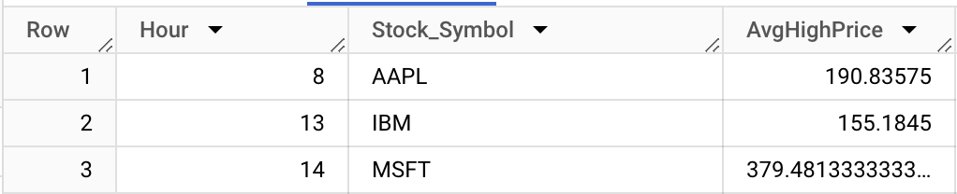
Our Complex Queries
Hour with highest average: Identifies the hour where stocks are performing their best on average
Had to extract hour from timestamp, find hourly average prices and determine highest average per company
Vital for investors or traders looking to optimize their trading strategies based on time-of-day patterns in stock prices

Slide 8
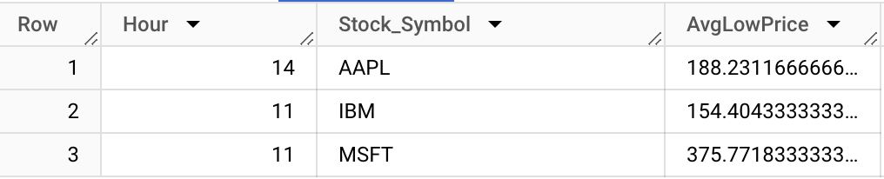
Our Complex Queries
Hour with lowest average: Identifies the hour where stocks are performing their lowest on average
Had to extract hour from timestamp, find hourly average prices and determine lowest average per company
Vital for investors or traders whose strategies involve buying low and selling high

Slide 9
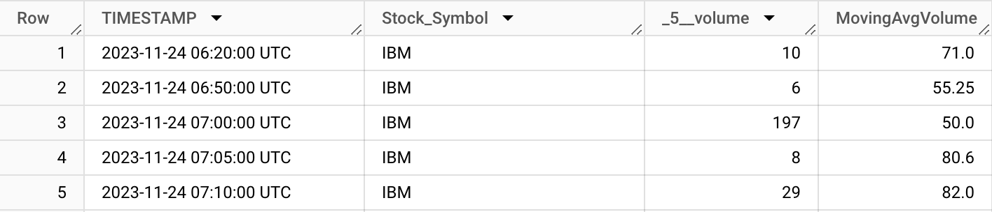
Our Complex Queries
Moving average volume: Calculates a moving average for the volume
Used window function with over clause to specify how the moving average should be calculated
Smooths out short term fluctuations
Helps identify unusually high or low volumes by comparing actual volume and moving average

Slide 10
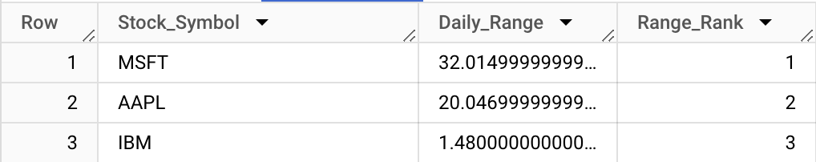
Our Complex Queries
Ranking by daily range: Determines daily prices range of each stock and ranks them
Uses RANK() as a window function
Stocks with higher volatility can provide more opportunities for profit

Slide 11
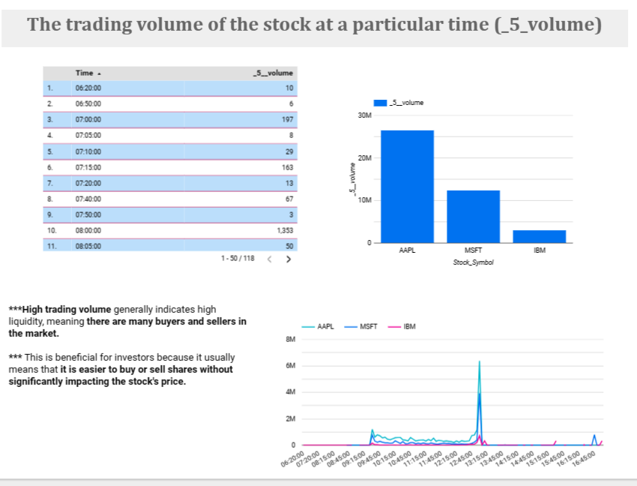
https://lookerstudio.google.com/reporting/f6e7df63-8ec9-4014-a44d-ab39160854e4

Slide 12
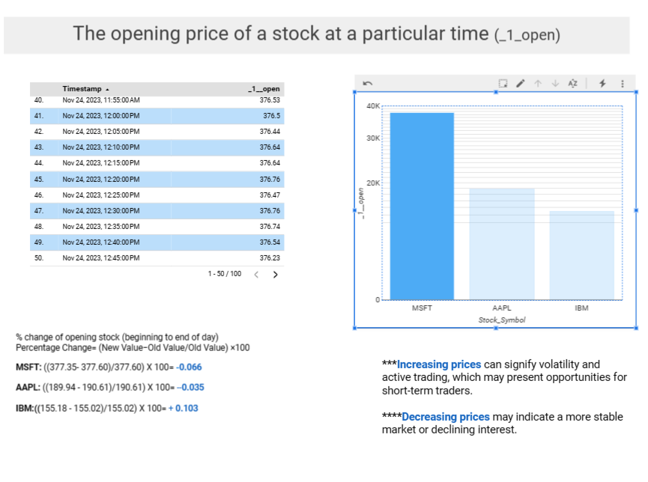
https://lookerstudio.google.com/s/onejgy8RKic

Slide 13
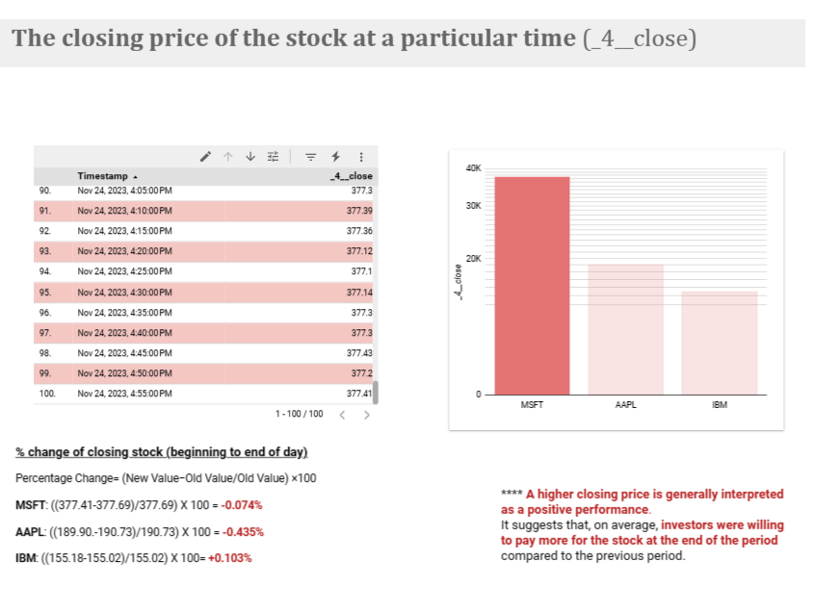
https://lookerstudio.google.com/s/jKdl2Qjavxc

Slide 14
Conclusion: Microsoft stock has the least volatile stocks for the day followed by Apple and IBM
Results:
Microsoft low volatility higher stability traits: A higher opening and closing price. A high opening price that is slowly decreasing.
Apple moderate volatility and moderate stability traits: An average opening and closing price. A moderate opening price that is slowly decreasing
IBM high volatility and low stability traits: A low opening and closing price. A low opening price that is slowly increasing.

